Slide 1
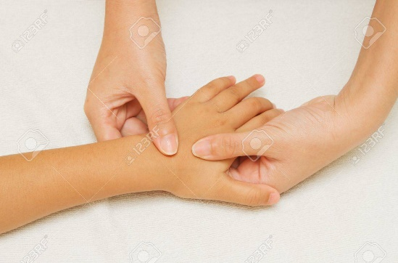
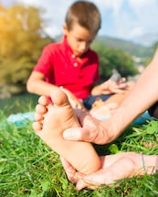

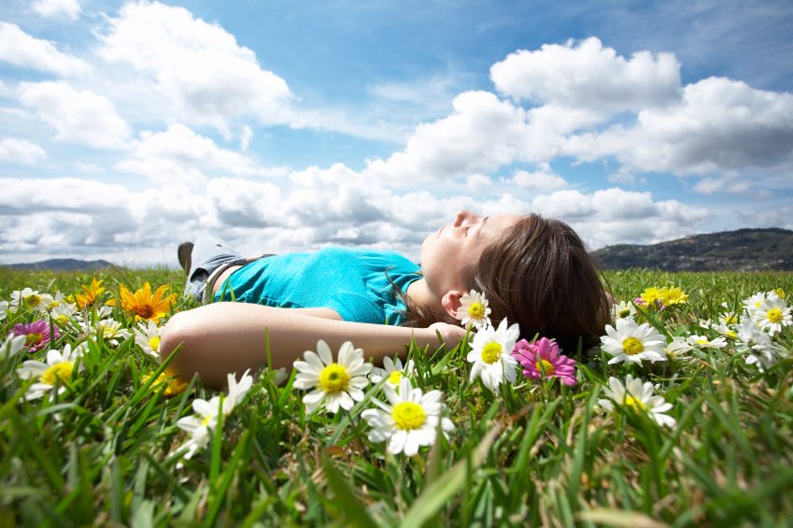
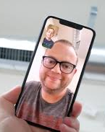
emotional well-being challenge card ONE
cloud watching
When the weather is good, take a walk into your garden and lie down and watch the clouds go by. See what different shapes and animals the members of your family see in the clouds – not everyone will see the same.
living room DISCO
Close the curtains, turn out the lights (or switch on your disco ball) and listen and dance to all your family’s favourite songs.
Hold a dancing competition.
massage
Using hand cream or
moisturiser, take it
turns to massage each
other’s hands and feet
(if you are feeling brave ☺)
Facetime your family
Ask your parent / carer’s permission
To facetime one of your family
members. They will love to chat with you and see your face.
Hide ‘n’ Seek
Play a traditional game of hide and seek as a family inside the house

