Slide 1
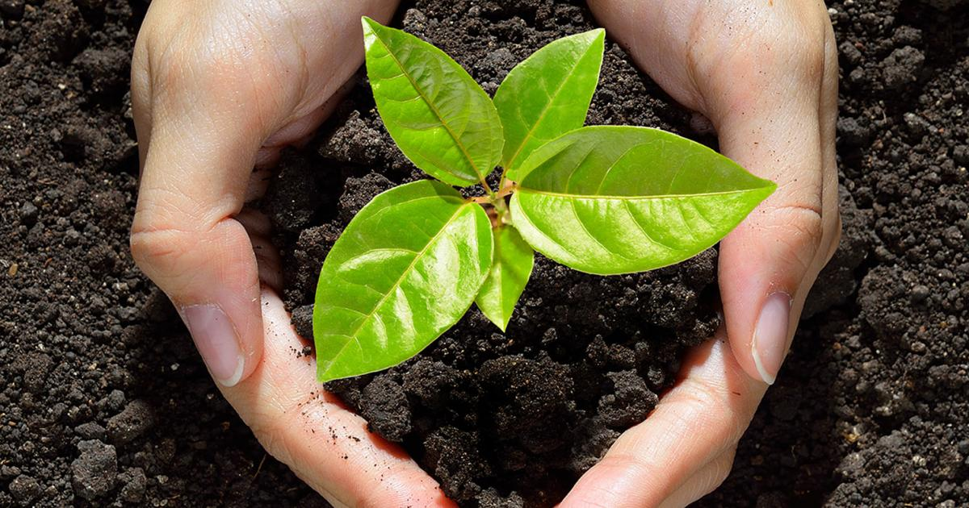
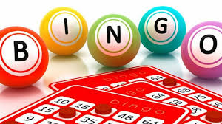
emotional well-being challenge card FOUR
Bingo
Children to create bingo cards for all family members and then call another family member to be the ‘official’ bingo caller.
Have fun!
growing things
If you have seeds at home, plant them, look after them and watch them grow.
If not, plant an apple or orange seed and see what happens.
Yoga Class
Visit www.youtube.com/user/CosmicKidsYoga
and choose a session that you know you will enjoy. Your challenge is to hold each pose for the same amount of time as Jamie (the online yoga instructor).
The Greatest Show!
As a family create your own play,
or re-enact a movie you all like.
Rehearse it, invite other family
members to watch via video call.
Teddy bear Picnic
Set up your teddies at lunchtime and have a picnic with them.

