Slide 1
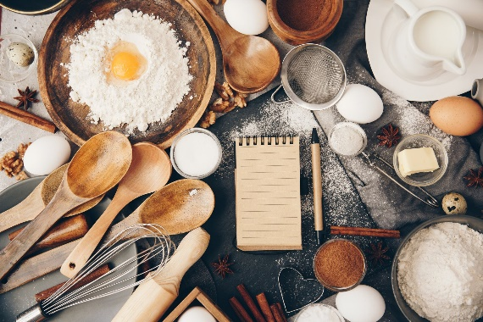

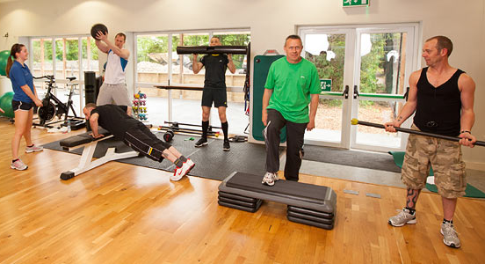
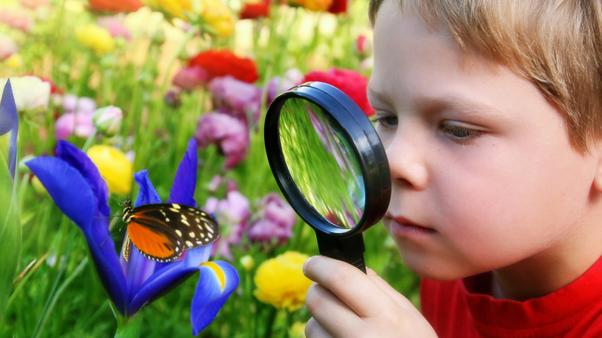
emotional well-being challenge card FIVE
Bug Hunt
Using a small pot, go hunting around your house and garden, or even whilst on a walk, collect some small bugs. Can you name them? Make sure you put them back where you found them from (unless the grown ups want them out of the house ☺)
Show and Tell
Everyone in your home has 5 minutes to go and find something that they would like to share with the rest of the family.
Time to sit back and listen to each other talking about their chosen item.
Baking
As a family spend time choosing things to bake, bake and then enjoy eating together.
Remember Game
Take it in turns to choose 6-10 objects to put on the table. Everyone study the objects. Take one away and guess what has been taking. Take it in turns to choose the objects. Challenge – take away 2 objects!
Circuit training
As a family, create your
own circuit training activities.
Spend 30 minutes working through the activities. Don’t forget to include a rest
station for everyone.

