Slide 1

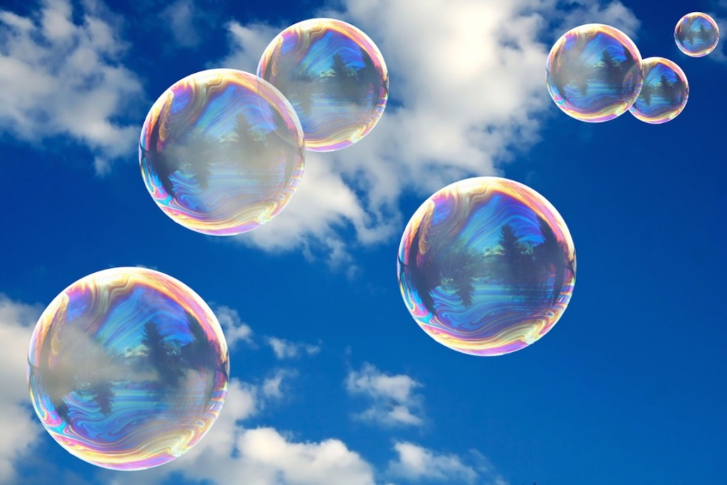
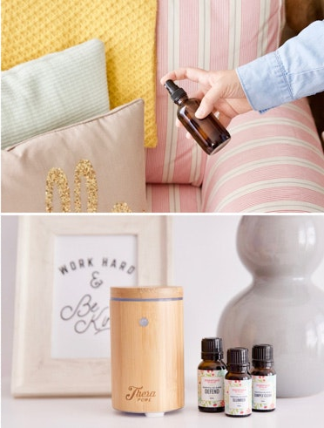
emotional well-being challenge card THREE
Bubble play
Use washing up liquid, shower gel, washing gel or shampoo (with grown-ups permission) to make bubbles.
Make your own wands using paperclips, straws, pipe cleaners, metal hangers.
Joke telling
Hold a family comedy event – everyone needs to make up their own or research 5-10 jokes to share with the family. Then decide who is the winner by the most amount of laughing created.
games, games, games
Time to find out the board games and hold a games afternoon. Children it is your job to make sure everyone knows the correct rules and plays fairly!
smells, smells, smells
Ask your parent / carer’s permission
hold a blindfolded smell session of some
some lovely things in your home.
Score each correct answer.
Selfie Fun
Have a selfie taking session – using lots of props (hats, scarfs, etc) and then share with family members far away.

